Slide 1
Welcome! Please take this time to socialize while we wait to get started. Your team building event will start soon.

Slide 2
Welcome to your very own
Escape Room:
Jewel Heist
by Outback Team Building & Training
Notes:
Good afternoon , and welcome to Outback Team Building & Training’s Escape Room: The Jewel Heist! My name is ________ and I will be your puzzle master for today’s activity.

Slide 3
Escape Room: Jewel Heist
Your Objective: Recover the Diamonds!
A criminal mastermind has stolen priceless diamonds which are hidden in the thief’s lair.
Your task today will be to find those diamonds.
To do this you will need to crack open the safes within the room, which we believe is where the diamonds are, along with other items of interest.
You will need to search the room for items and clues, and solve riddles critical in helping you crack the safes.
Notes:
We’ve been tracking a criminal mastermind who’s stolen several priceless, white, diamonds, and we believe they’re locked in cases in the room I will be sending you into momentarily. Today, you will be tasked with working together as a team to uncover clues and solve a series of puzzles to obtain several codes which will open a locked box and recover the jewels. We expect the thieves to return in 60-90 minutes, so you have very little time to get the diamonds and get out of here!

Slide 4
Escape Room: Jewel Heist
Be creative with your thought process, not everything is as it appears.
Communicate with your team, explore all options.
You must act fast, with only 90 minutes to find the diamonds!
Winning teams today, will be those who find the diamonds within the time frame, and can prove it to your host.
Return back to the main room to check in with your organizer as soon as you have the diamonds.
Winning teams today, will be those who find the diamonds within the time frame, and can prove it to your host by providing them with the secret code.
Notes:
Today you will be working as one cohesive team, however you’ll need to bring together all of your individual talents and skills to solve these puzzles. You may choose to create a strategy or just dive in headfirst - how you tackle these challenges is up to you! To be successful, you’ll need to use:
• Be creative
• Think outside of the box
• Be observant
• and have effective communication

Slide 5
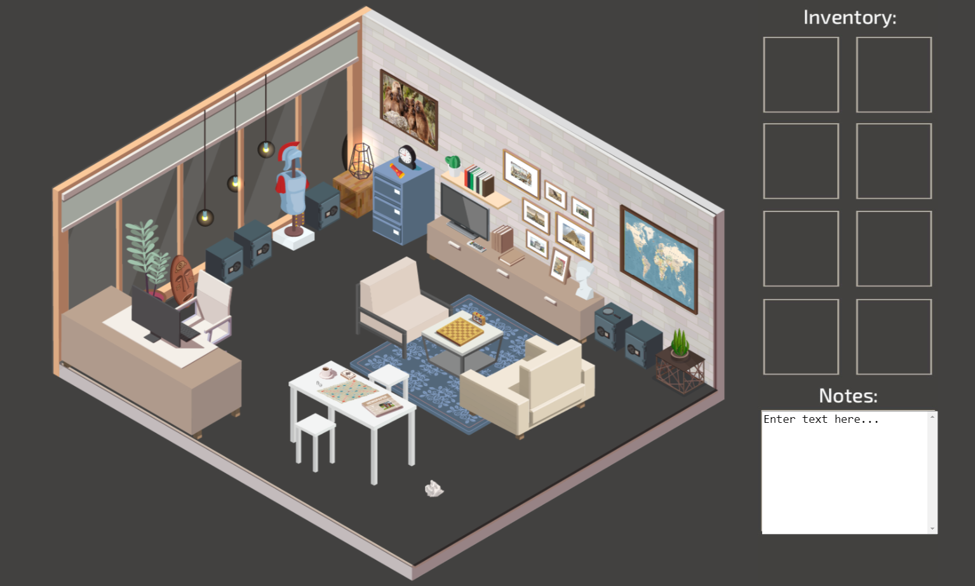
Tips For Success
Before entering the room, you will nominate 1 person to be the leader. This person will be responsible to lead the navigation throughout the activity. There will be opportunity to share the role once you get started.
Search the room for items and clues, by clicking and hovering over areas and objects to interact with them.
Everyone in your group should be taking their own notes – anything could be a clue!
As you find items, they may be added to your inventory to use throughout the activity.
Remember your time limit, keep an eye on your clock.
Notes:
In just a moment, I will be breaking you all up into teams where you will be sent to your own virtual (or in-person) breakout room. When you arrive, you will nominate one person to be the Captain. This individual will be the one who shares their screen and logs into the virtual Escape Room using a link and Entry code I will provide you with in just a moment. Know that you will face challenges and it’s important to be creative to get through them!

Slide 6
Game Play Tips & Tricks
Need Help?
If you have exhausted all options, from all team members and can’t move forward you may ask for help.
Identify which clue you are stuck on, there are 5 in total.
Contact your organizer to ask for help.
Notes:
Your goal is to solve all the puzzles in the room, which will in turn unlock the safe holding the stolen diamond before the time runs out.
Tips:
Search the Room for items and clues.
Click around the room – interact with it.
Everyone in your team should be taking notes – remember, anything could be a clue
Keep your eyes on the clock

Slide 7
Leaders - Do This First
Please complete the steps below if you are playing in a fully virtual environment
In the share screen window, select share computer sound for optimal team experience.
The leader can share mouse control while sharing their screen by selecting a team member in the list from the toolbar.
Notes:
Before I send you off, here is a quick reminder on how to share your screen as this is critical for your team captain.
Zoom: At the bottom of your screen everyone should see a green button to share your screen. It’s that easy. Be sure to do this when you get to your breakout room.
Teams: At the top right of your teams window there is a square with an arrow in it. It’s that easy. Be sure to do this when you get to your breakout room.
One more technical tip, you can take over mouse control of the team captain if your team decides to have someone else take the wheel in clicking in the room.
Zoom: At the top of your screen there should be viewing options. Within these options there is a Request Remote Control. This will allow you to take over the mouse from the team captain.

Slide 8
Get Started!
Activity Code: (provided in your confirmation email)
Only the team leader uses this code to enter the activity
Good Luck!
Notes:
Is everyone ready to get started? Your code is now displayed on the screen. Everyone please write this down or snap a photo – if you end up being the team captain, you will need it to login to the virtual escape room.
I have now sent the link to your virtual room in the Chat. Everyone please click on this. Once I send you to your breakout rooms, nominate that ONE person to be your team captain and only THEY will login. Everyone else can close their web browser.
Once you click on the link, a welcome screen will arrive. Follow the Instructions provided. Good luck!
Can you outsmart the thieves, crack their codes and find the diamonds before they return?
Will you make it?
Your time starts…NOW!

Slide 9
You are back in the main meeting room. Please be patient as your organizer may be assisting other teams. If you need help, please reach out to your organizer. Thanks!

Slide 10
AND THE WINNER(S) ARE…
Brought to you by Outback Team Building & Training!
Notes:
Announce the teams that were able to solve the escape rooms and provide the organizer with the secret code. You could also announce the team to complete the Escape Room 1st, 2nd, etc.

Slide 11
Puzzle Conclusions
Jewel Heist – Puzzle 1 Conclusion
Jewel Heist – Puzzle 2 Conclusion
Jewel Heist – Puzzle 3 Conclusion
Jewel Heist – Puzzle 4 Conclusion
Jewel Heist – Puzzle 5 Conclusion
Jewel Heist – Activity Walkthrough
Notes:
You can share the puzzle conclusions with the participants if time permits/if your team members would like to see the solve.

Slide 12
THANK YOU FOR PARTICIPATING!
Notes:
Thank you all for participating!

