Slide 1
Welcome! Please take this time to socialize while we wait to get started. Your team building event will start soon.

Slide 2
Welcome to your very own
Escape Room:
Mummy’s Curse
Brought to you by Outback Team Building & Training

Slide 3
Escape Room: Mummy’s Curse
Retrieve the Talisman!
Your team has been transported into a pyramid cursed by a restless mummy. Now you must uncover the secrets of Ancient Egypt in order to lift the mummy’s curse and return before the portal closes. Fortunately, you found a journal belonging to an archaeologist who disappeared years ago – look for clues that will help you solve the mummy’s puzzles and lift the curse!
Your goal is to solve all the mummy’s puzzles and retrieve the talisman in the locked box before the time is up! The first team to unlock the final case will be crowned today’s winner.

Slide 4
Escape Room: Mummy’s Curse
Be creative with your thought process, not everything is as it appears.
Communicate with your team, explore all options.
You must act fast, with only 90 minutes to find the talisman!
Winning teams today, will be those who find the talisman within the time frame, and can prove it to your host.

Slide 5
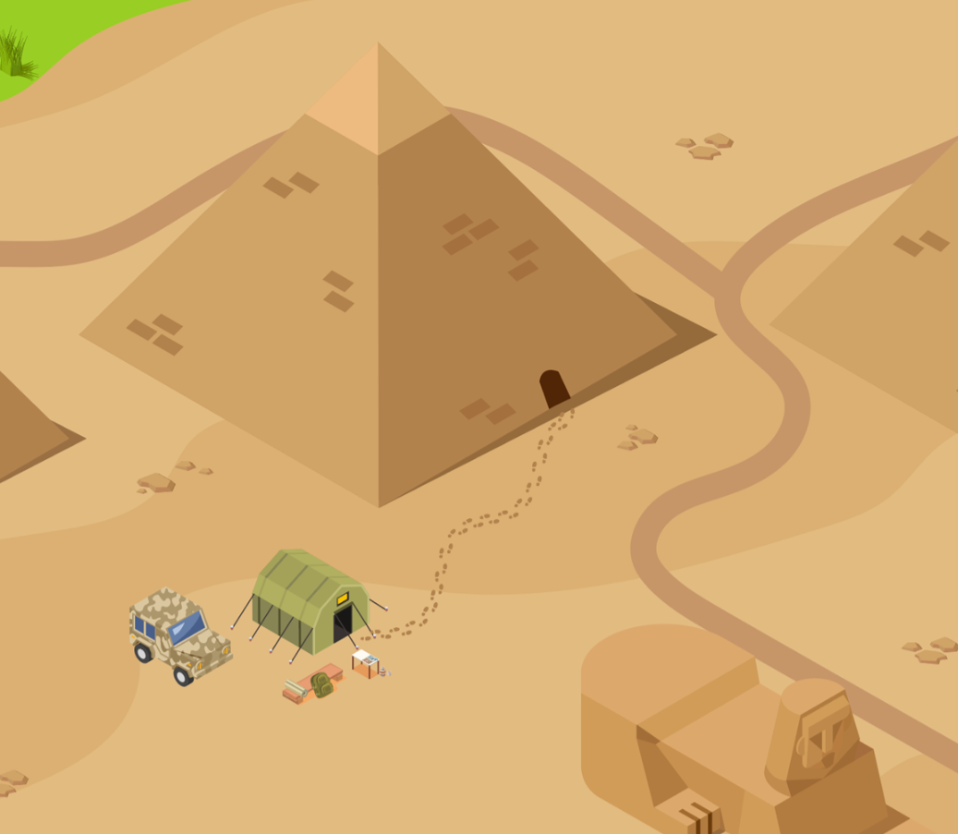
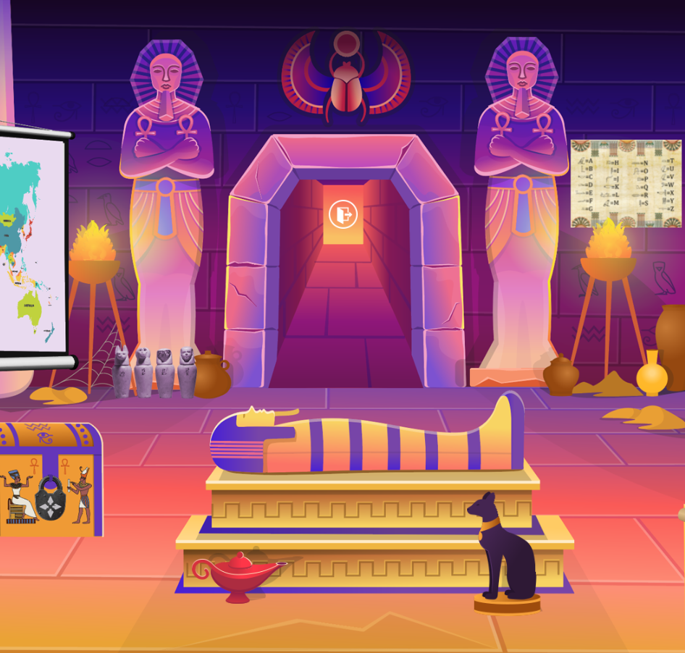
Tips For Success
Before starting, you will nominate 1 person to be the leader. This person will be responsible to lead the navigation throughout the activity. There will be opportunity to share the role once you get started.
Search the area for items and clues, by clicking and hovering over areas and objects to interact with them.
Everyone in your group should be taking their own notes – anything could be a clue!
As you find items, they may be added to your inventory to use throughout the activity.
Remember your time limit, keep an eye on your clock.

Slide 6
Game Play Tips & Tricks
Need Help?
If you have exhausted all options, from all team members and can’t move forward you may ask for help.
Identify which clue you are stuck on, there are 6 in total.
Contact your organizer to ask for help.

Slide 7
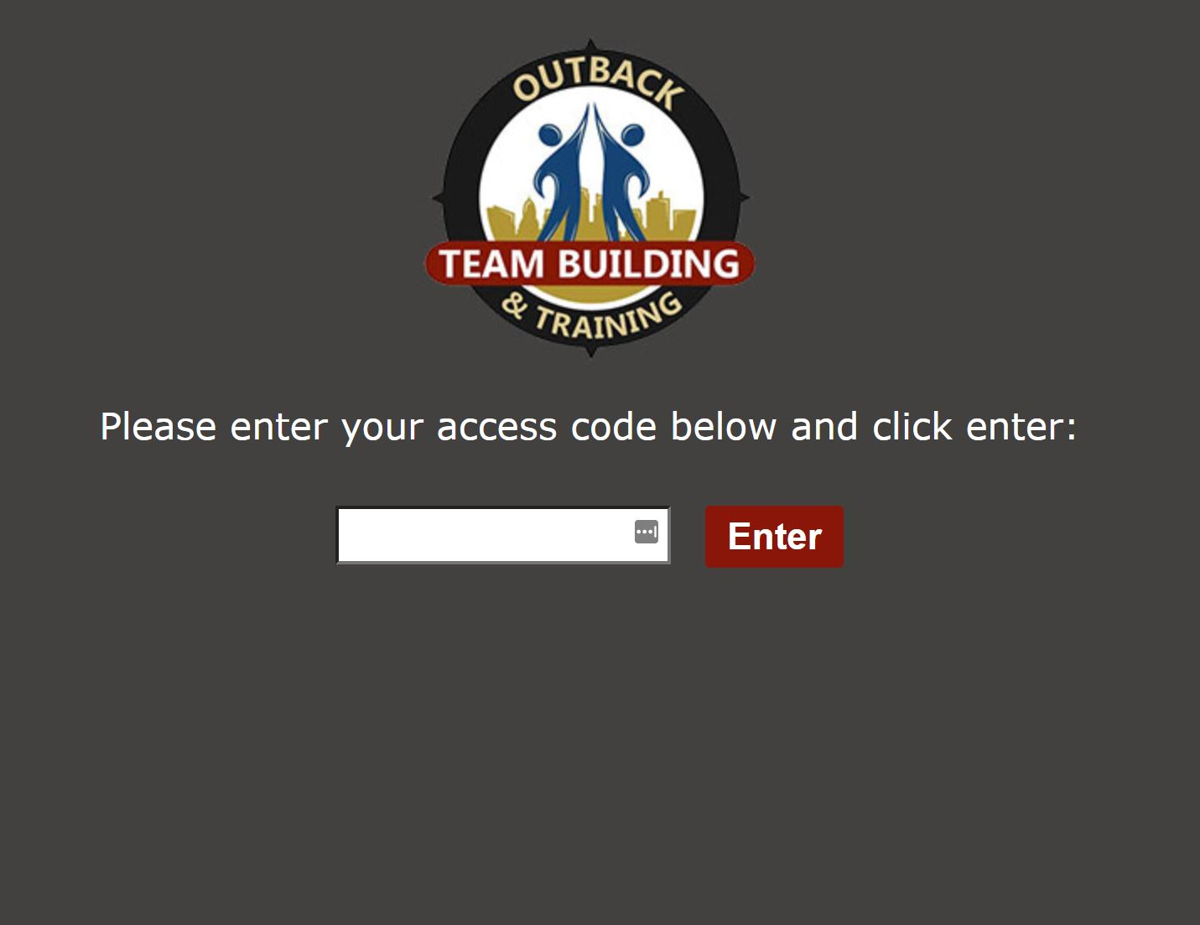
Leaders - Do This First
Please complete the steps below if you are playing in a fully virtual environment
In the share screen window, select share computer sound for optimal team experience.
The leader can share mouse control while sharing their screen by selecting a team member in the list from the toolbar.
Notes:
Before I send you off, here is a quick reminder on how to share your screen as this is critical for your team captain.
Zoom: At the bottom of your screen everyone should see a green button to share your screen. It’s that easy. Be sure to do this when you get to your breakout room.
Teams: At the top right of your teams window there is a square with an arrow in it. It’s that easy. Be sure to do this when you get to your breakout room.
One more technical tip, you can take over mouse control of the team captain if your team decides to have someone else take the wheel in clicking in the room.
Zoom: At the top of your screen there should be viewing options. Within these options there is a Request Remote Control. This will allow you to take over the mouse from the team captain.

Slide 8
Get Started!
Activity Code:
(provided in your confirmation email)
Only the team leader uses this code to enter the activity
Good Luck!
Notes:
Once you click on the link, a welcome screen will arrive. Follow the instructions provided. Good luck!

Slide 9
You are back in the main meeting room. Please be patient as your organizer may be assisting other teams. If you need help, please reach out to your organizer. Thanks!

Slide 10
AND THE WINNER(S) ARE…
Brought to you by Outback Team Building & Training!
Notes:
Announce the teams that were able to solve the escape rooms and provide the organizer with the secret code. You could also announce the team to complete the Escape Room 1st, 2nd, etc.

Slide 11
Puzzle Conclusions
Mummy’s Curse – Puzzle 1 Conclusion
Mummy’s Curse – Puzzle 2 Conclusion
Mummy’s Curse – Puzzle 3 Conclusion
Mummy’s Curse – Puzzle 4 Conclusion
Mummy’s Curse – Puzzle 5 Conclusion
Mummy’s Curse – Puzzle 6 Conclusion
Notes:
You can share the puzzle conclusions with the participants if time permits/if your team members would like to see the solve.

Slide 12
THANK YOU FOR PARTICIPATING!
Brought to you by Outback Team Building & Training!

